Slide 1
2. MCM-6 Good Housekeeping at Municipal Facilities:
Parks and Open Space Maintenance
Green Country Stormwater Alliance (GCSA)
Employee Training Series
Prepared by INCOG
March 2021
Notes:
This is the 2nd of 6 annotated PowerPoint (aPPT) Modules covering MCM-6 “Good Housekeeping” employee training.
This module covers parks and grounds of the municipally-owned public areas.
Permitted MS4s, particularly cities, own many such areas, and the maintenance activities can contribute pollution in stormwater runoff.

Slide 2
Parks and Grounds Maintenance
This presentation provides suggestions and ideas for controlling pollutants in stormwater runoff for the following activities:
  Plant Selection
  Watering
  Debris Management
  Soil Management
  Pesticide and Herbicide Applications
Notes:
All of these activities have the ability to negatively impact stormwater quality.
We will cover these 5 critical areas in which Best Management Practices (BMPs) can help reduce and eliminate pollutants in stormwater runoff.
Most of these are common sense when you think about them, but nonetheless they are often forgotten when planning the day’s activities.
The OKR04 permit requires that employees be trained on and implement pollution control practices.

Slide 3
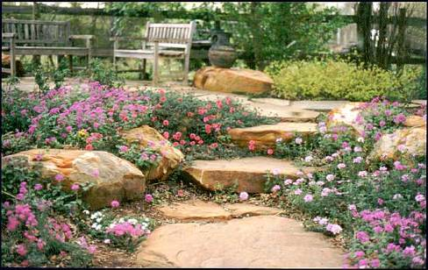
Plant Selection
Native or adapted perennial vegetation will be better suited to local climates and require less water, fertilizer and fewer pesticides.
Notes:
Whenever possible, select native plant species for municipal landscaping in parks and other open spaces.
Native plants have adapted to the local weather conditions and are frequently more resistant to diseases and pests.
Native plants require less watering and maintenance which means less work, lower costs and hardy growth.
Perennials will come up year after year which means less work at the beginning of each growing season.
Annuals will need to be planted each season but they also have a place in the overall plan.
Allow for the additional time annuals need if these are in your planting rotation.

Slide 4

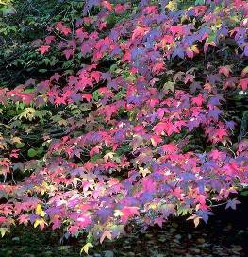
Plant Selection
Consult the following sources to determine which plants will do well in your situation:
Master Gardner
Local Nursery
OSU Extension Service
County Conservation Districts
Notes:
The following are important sources of information about plant selection and care.
All of these sources know what plants will do well in your areas.
Plant selection should be based upon which ones are best suited to the local climate.
Proper plant selection ensures that your landscaping will require less problematic care and maintenance.
Some things to consider are: soil type, minimum and maximum temperatures, amount of sun or shade, water needs, number of growing days, disease resistance, invasiveness, fertilizer needs, etc.
The Master Gardener Program has volunteers all across Oklahoma and in many other states.
They can be contacted through the OSU Extension Service.

Slide 5
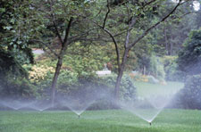
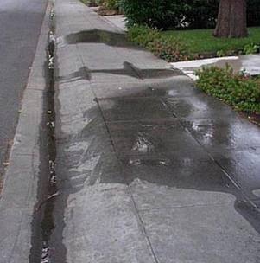
Watering
Avoid over-watering to prevent excess runoff.
Avoid runoff by adjusting watering time, direction and volume of spray heads.
Check soil moisture and water only when the top 4” to 5” of soil is dry.
Notes:
Over watering of landscapes and plant beds wastes water and increases your stormwater pollutant load.
In hot weather, watering at night or the early morning hours will reduce evaporative losses thus saving water and helping to control costs.
Be aware that aerobic land application sprinklers will come on when tanks reach a certain level, whether it is raining or not.
Many such automatic watering systems waste water under these circumstances and cause increased and wasteful runoff.

Slide 6
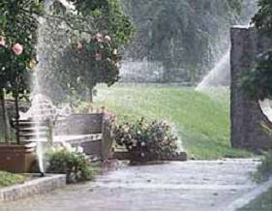

Watering
Monitor rainfall and turn off sprinklers during rainy weather.
Install rain and freeze sensors on automated sprinkler systems whenever possible.
Notes:
If you use an automated watering system, be certain that it has controls to avoid operation during rainfall or freezing weather.
Such systems can be set to turn off sprinklers during rainy weather or freezing conditions.
This not only saves you money, but it preserves our water resources and helps protect our surface waters from added pollution and erosive flows.

Slide 7
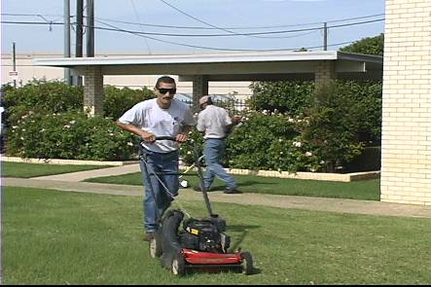
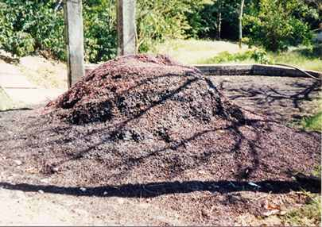
Debris Management
Use a mulching mower, leave clippings on the lawn and cut grass as high as possible.
Compost leaves for use as a soil amendment or shred and add to flower beds as mulch.
Notes:
In terms of landscaping, “debris” refers to plant waste such as grass clippings, raked leaves and plant trimming waste.
Mowing grass higher helps shade the soil, keeping the roots cooler and reducing evaporative losses from the soil.
Also, a longer leaf blade means more photosynthesis which provides the energy necessary to support a strong root system.
A stronger, deeper root system doesn’t dry out as quickly and doesn’t need watering as often.
Mulching’s greatest advantage is the direct return to the lawn and soil of nutrients and organic matter needed for lush growth of lawns.
When mulching is not possible, collect and compost grass clippings and leaves.
Composting reduces the need for disposal of plant waste and provides valuable nutrient-rich bedding soil for healthier landscapes.

Slide 8
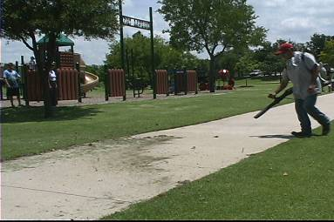
Debris Management
Sweep paved surfaces or blow clippings and trimmings onto grass rather than hosing down.
Notes:
Another way to return grass clippings to the lawn is to sweep or blow the clippings back onto the grass.
This allows soil microbes to break down the grass blades releasing the nutrients into the root zone to be used by the growing grass.
Cut grass and fallen leaves are organic-rich materials that, when in a stream or pond, consume oxygen in the water.
Oxygen consumption of such materials in streams and ponds is caused by microbes and other organisms growing in the water body.
The excess growth of microbes and organisms in the water results in the lowering of the available oxygen for fish and other aquatic organisms.
Low dissolved oxygen in water is a sure sign of ecosystem stress and one of the most common problems of pollution in urban streams and ponds.

Slide 9
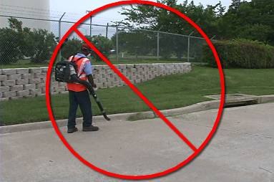
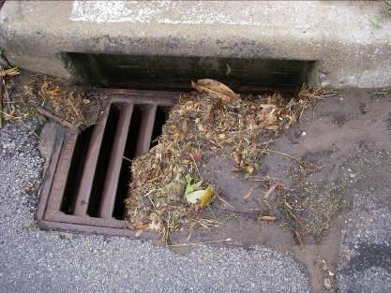
Debris Management
Never dispose of grass clippings, leaves or other debris in the storm drain.
Remove accumulated litter and debris from storm drain inlets.
Notes:
It may seem harmless and very convenient to blow or sweep lawn clippings into storm drain inlets, but DON’T!
Neither should any type of trash or chemical be poured or placed into a storm drain inlet.
Grass clippings and leaves can accumulate inside storm drains, building up in size until the drain is blocked restricting flow of runoff.
In addition, lawn chemicals adhere to grass clippings which can then be transported directly into a water body through a storm drainage system.
Storm drains transport their contents directly to channels that discharge to local streams and ponds; there is no treatment of storm drain water.

Slide 10
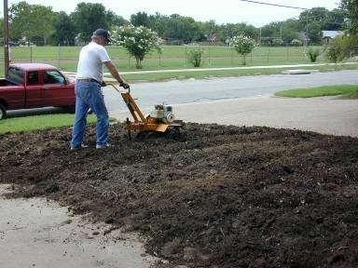
Soil Management
Aerate and add compost to the soil to reduce fertilizer needs, improve drainage and promote root growth.
Have soil tested before the application season to determine fertilizer needs.
Notes:
Compost is an excellent substitute for chemical fertilizers, especially when the compost is produced locally from vegetative debris.
Chemical fertilizers often are added aggressively, more so than the plants require.
This results in excess amounts of nutrients which are washed off during rainfall that can pollute streams and ponds.
Excess chemical fertilizers can also percolate down through the soil into shallow ground water where it may affect drinking water sources.
The city’s stormwater permit requires the reduction of excess nutrient overload of local waterbodies.
How can you determine the ideal application limit? Before applying fertilizers, have the soils tested for nitrogen and phosphorus.
The soil test results will recommend application needs and rates, if any, for each area tested.

Slide 11
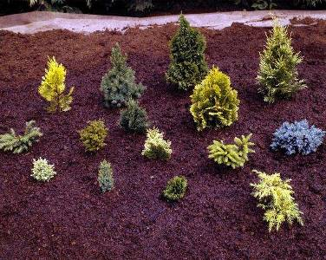
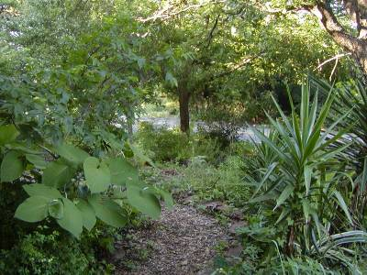
Soil Management
Limit soil erosion by planting vegetation on bare areas and using mulch or matting for landscaped areas.
Notes:
Bare ground is prone to erosion during rainfall runoff, and the impacts to streams and ponds can be severe.
City properties with landscaping that has exposed bare soils need to have better ground cover or mulch applied to reduce soil loss via erosion.
Mulch lessens the impact of rain drops and minimizes the amount of soil knocked loose and suspended.
It also shades the soil minimizing evaporative losses and slows the water flowing over the surface.
Mulch absorbs some of the water in rainfall reducing the amount of runoff.
Plants can accomplish the same things by slightly different mechanisms which makes areas lush with a variety of plants effective against soil erosion.
The greater the amount and diversity of plants in landscaping results in more healthy soils, less nutrient loss, less erosion, and more attractive landscaping.

Slide 12

Pesticide and Herbicide Practices
Follow manufacturer’s recommended safety, storage and disposal procedures for pesticides and herbicides.
Follow label directions precisely when mixing or applying pesticides or herbicides.
Notes:
Pesticides and herbicides are toxic chemicals designed to selectively kill certain types of insect pests and nuisance plants, respectively.
Each chemical has very specific requirements from the manufacturer on how to properly dilute and use each chemical.
Manufacturer’s directions include instructions for the proper use, storage and disposal of waste products and materials that come in contact with the chemicals.
Never mis-use any pesticide or herbicide; always follow manufacturer’s instructions carefully.
The most important safety gear are use of proper gloves and eye protection, and even breathing respirators may be needed for certain chemicals.
Do not wear leather gloves when mixing chemicals; the gloves will absorb the chemicals allowing chemicals to be in contact with your skin.
Wear manufacturer-recommended rubber, latex, nitrile or other type gloves that materials can’t penetrate. Elbow length gloves are best.
Eye protection and a safety apron are also recommended by manufacturers. Consider using a face shield for even more protection if needed.

Slide 13
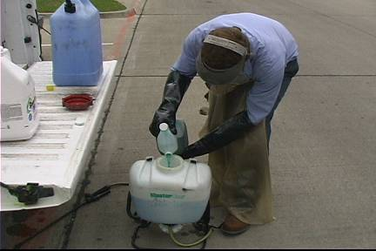
Pesticide and Herbicide Practices
Mix pesticides and herbicides where spills will not soak into the ground or enter the sanitary sewer or storm drainage system.
Promptly clean up any spills.
Notes:
It’s also important to prepare chemical sprayers and other equipment in a safe location where chemical spills can be contained and cleaned up if they occur.
Try to avoid open areas where wind can cause back-spray of liquids or dust and other airborne particles might enter the spray tank and clog nozzles or air ports.
Notice the proper use of safety gear by this employee in the picture: face shield, long chemical apron, elbow length gloves.
Be aware of the locations of all storm drains, stormwater drainage ditches and channels and local creeks.
When a spill does occur, protect these areas from contact with the spilled chemical by quickly deploying the proper absorbents.
Always follow manufacturer’s directions for proper spill cleanup and waste disposal.
You should also have locally prepared Standard Operating Procedures (SOPs) or other written instructions for handling of pesticides and herbicides.

Slide 14
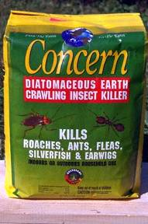
Pesticide and Herbicide Practices
Use landscaping pesticides and herbicides only as needed.
Use non-toxic substitutes for chemicals when possible.
Carefully time your applications to achieve maximum results.
Notes:
Pesticides and herbicides are most effective when applications are timed to coincide with an insect’s or plant’s more vulnerable life-stage.
For plants this is frequently during an active growing stage or early development. For insects this might be an early developmental stage.
The good news is that you don’t need to be a biologist or understand the many different types of life stages of insects and plants.
The manufacturer’s directions will specify the best time of year and the best conditions under which you should apply their products.
There are many less toxic alternatives to more traditional pesticide and herbicide chemicals that you can consider using.
Talk with other cities and check internet sources to see if less toxic alternatives might work for some of your applications.
Timing of applications is also critically important. Again, follow manufacturer’s instructions to maximize effectiveness of applications.

Slide 15
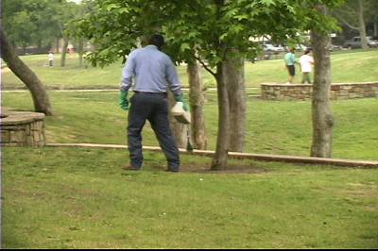
Pesticide and Herbicide Practices
Carefully select the most appropriate product for the problem requiring treatment.
Apply pesticides and herbicides to the problem area only. Spot applications will save time, money and introduce fewer toxins to the environment.
Notes:
An alternative to a broadcast spreader or sprayer is targeted spot applications.
This method focuses the chemicals onto areas of greatest need while sparing wider areas that do not need chemical applications.
This method can significantly reduce the amount of chemicals applied which will save time and money.
In addition, the reduced amounts of chemicals used results in having lesser amounts of toxic chemicals washing off during rainfall into local streams and ponds.

Slide 16
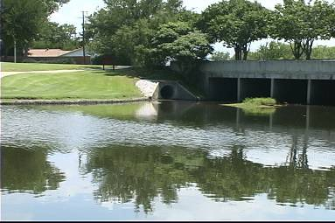
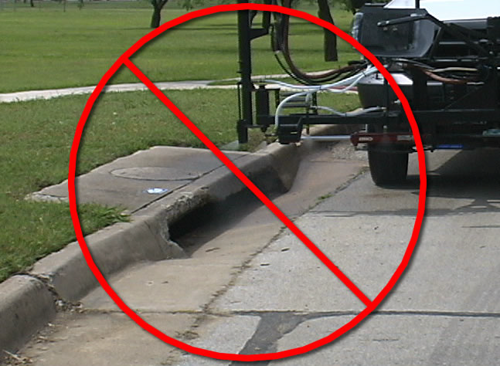
Pesticide and Herbicide Practices
Do not spray impervious surfaces where the spray could be washed into the storm drain system.
Don’t apply chemicals directly to sensitive areas including streams, lakes, wetlands or drainage areas.
Notes:
Impervious surfaces are those areas that do not allow for rainfall or be absorbed into the ground.
Examples are concrete or asphalt streets, driveways, sidewalks and parking lots.
Pesticides and herbicides sprayed on impervious surfaces will wash off with the next rain event.
Some of these chemicals will adhere to silt and small organic particles and be carried to the nearest body of water with the next flush of water.
Of particular concern is avoiding spraying or apply chemicals immediately next to waterbodies like streams, ponds or near gutters or storm drains.

Slide 17
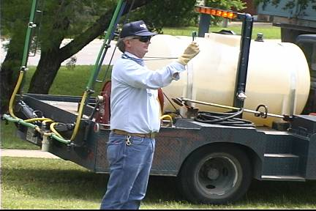
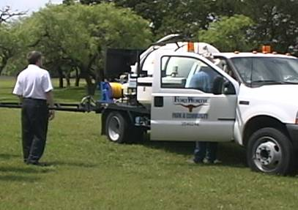
Pesticide and Herbicide Practices
Don’t apply during windy conditions or when rain is predicted within 24 hours.
Report suspected pollution problems regarding pesticide or herbicide applications to your supervisor.
Notes:
Chemicals sprayed during windy conditions can drift to sensitive areas or to areas not needing treatment.
Wind-blown chemical spray can also drift into streams, ponds or the stormwater collection system.
Most manufacturers recommend that their chemicals should not be applied within 24 hours prior to an anticipated rain event.
If you find that there has been any chemical over-spray into sensitive areas (streams or ponds) or chemicals spilled, report such “releases” to your supervisor.

Slide 18



End of Module 2 on
Parks and Open Space
Maintenance
Vernon Seaman
Manager, Envir. And Energy Planning
INCOG
Two West 2nd Street, Ste 800
Tulsa, OK 74103
(918) 579-9451
vseaman@incog.org
Notes:
This concludes the 2nd of 6 annotated PowerPoint (aPPT) Modules for local MCM-6 training.
Training Presentations 2 through 5 cover the training subjects listed in the OKR04 permit.
The final Presentation 6 covers additional facilities that may be owned by GCSA Members.
INCOG expects to be able to return to physical half-day GCSA Employee Training Workshops in the second half of 2021.
In this interim period, INCOG will continue to prepare annotated PowerPoints (aPPTs) for local staff training use.

